Slide 1
Determination of the Absolute Phase Between a Field and its Second Harmonic for use in a Coherent Control Experiment
Thesis Defense
Chris Rupley
July 20, 2004

Slide 2
Outline
Motivation for current work
Theory
Experiment and Results

Slide 3
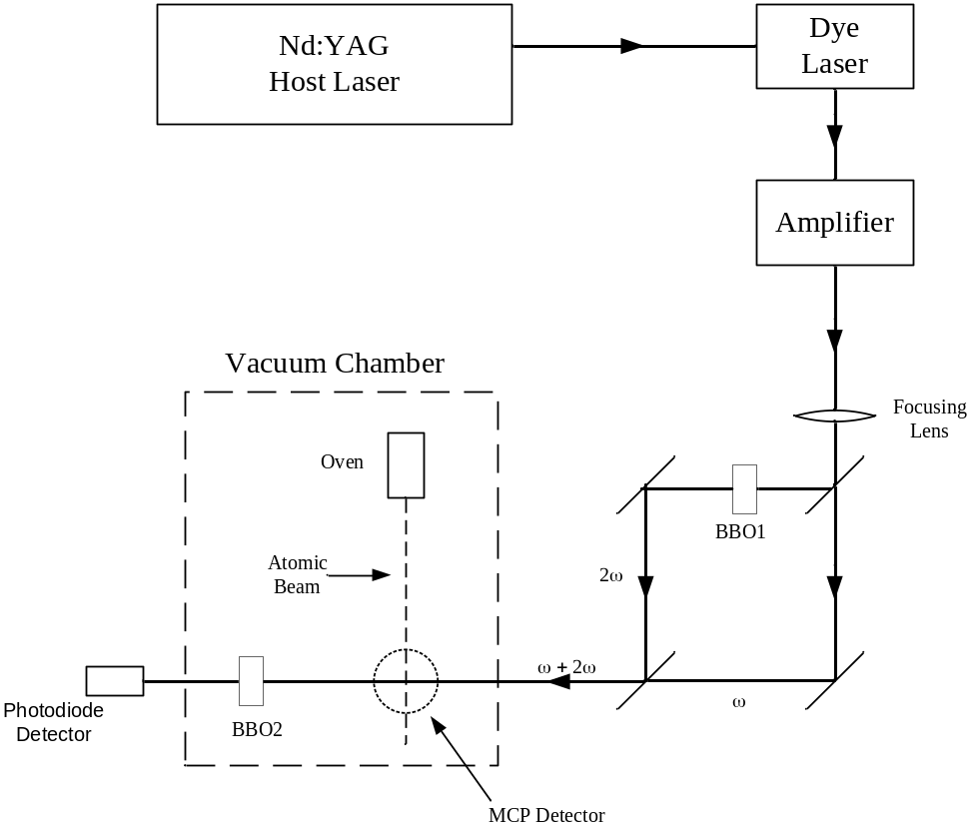
Motivation
Previous work
Experimental setup

Slide 4
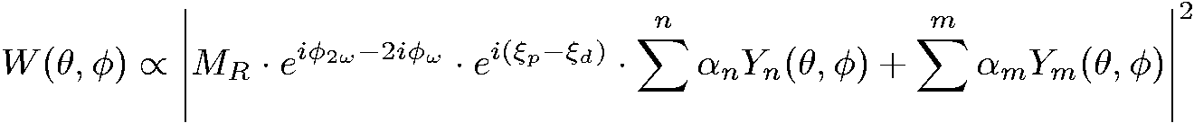
pad
equations

Slide 5

Pad images

Slide 6
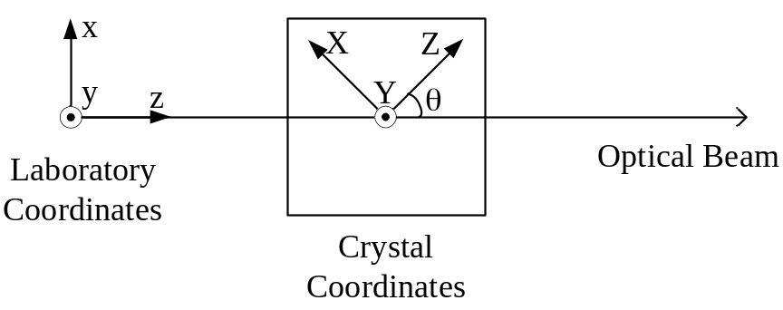
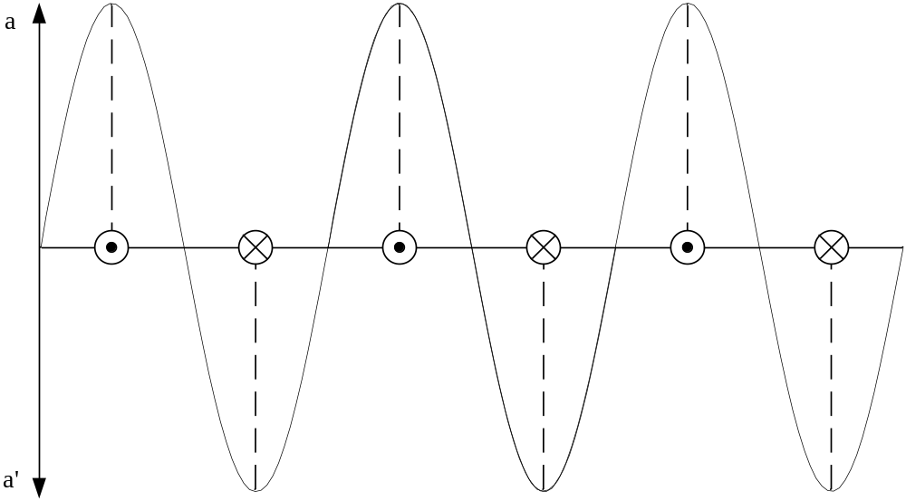
Theory
Coordsys, perppol

Slide 7
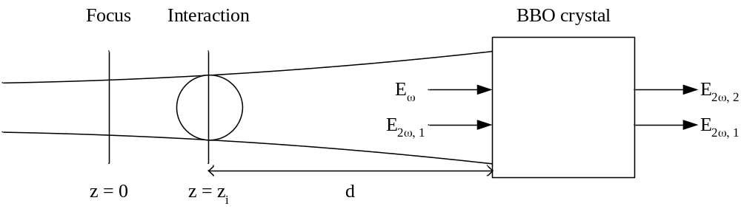

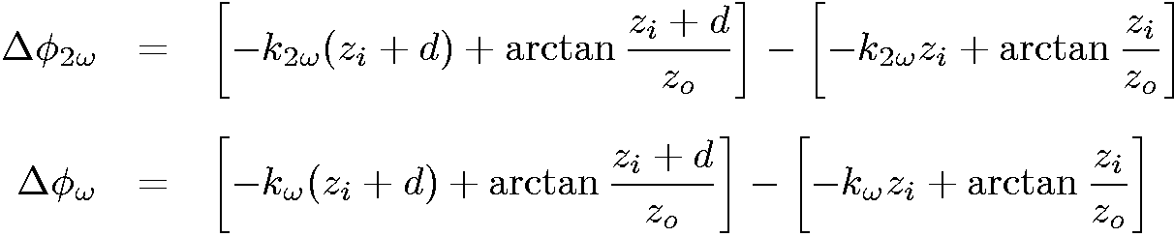
Propagation

Slide 8

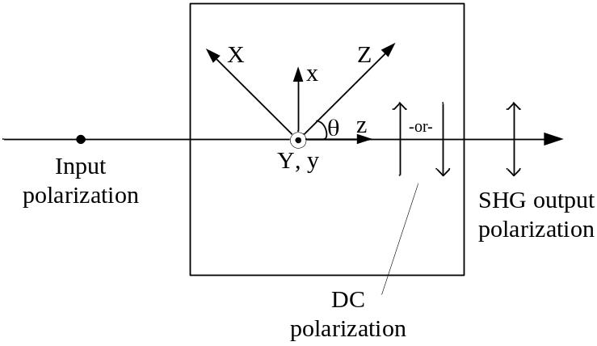


Second Harmonic Generation
BBO crystal

Slide 9
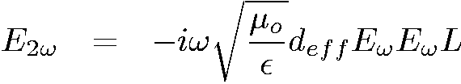
SHG2

Slide 10
SHG3

Slide 11
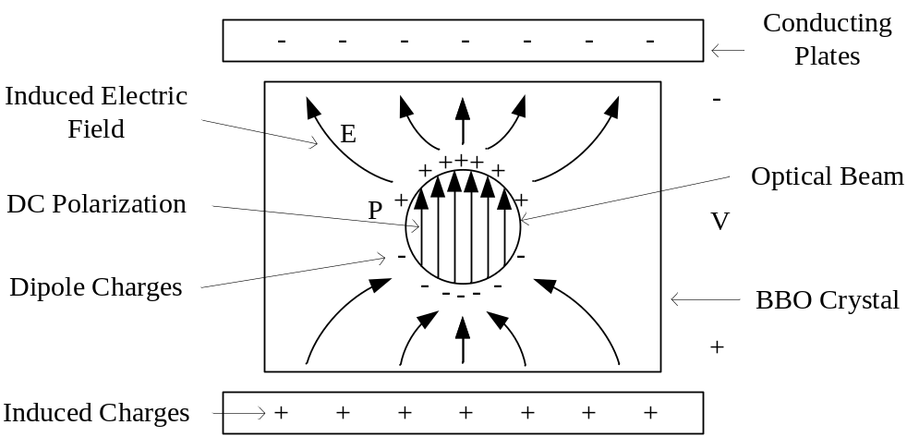
OR

Slide 12
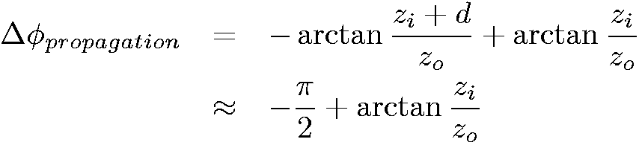
Summary

Slide 13




summary2
BBO crystal
PD

Slide 14
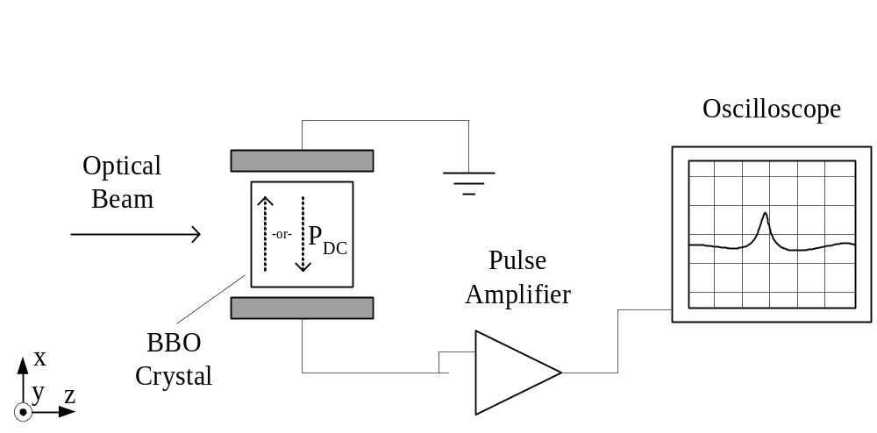
Experiment

Slide 15
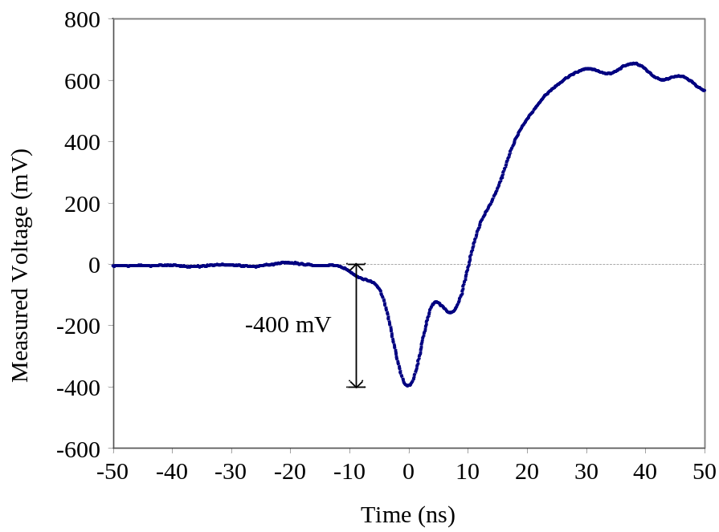
Result

